Slide 1
MOCK 01 – Read FAT File

Slide 2
What is the FAT File?
The FAT file system (File Allocation Table) is heavily based on the file map model in terms of its on-disk layout
This file system was used on all versions of MS-DOS and PC-DOS, and on early versions of Windows
It is a reasonably simple, reasonably robust file system.
Three basic variants of the FAT file system:
Floppy disks and small hard disks usually use the 12-bit version, which was superseded by the 16-bit version as hard disks became bigger. This in turn was superseded by the 32-bit version as disks became bigger still.

Slide 3
FAT File Overview
Any disk is made up of surfaces (one for each head), tracks and sectors. → we can consider a disk as a simple storage area made up just of a number of sectors (index start by 0).
All blocks are the same size, 512 bytes, on practically all FAT file systems.
Howewer, large disks can have too many blocks for comfort, so blocks are sometimes grouped together in pairs (or fours, or eights, etc...); each such grouping is called an allocation unit.
The FAT file system actually works in allocation units, not blocks

Slide 4
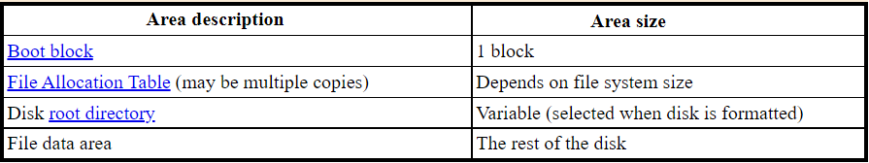
Disk Format – Basic Layout

Slide 5
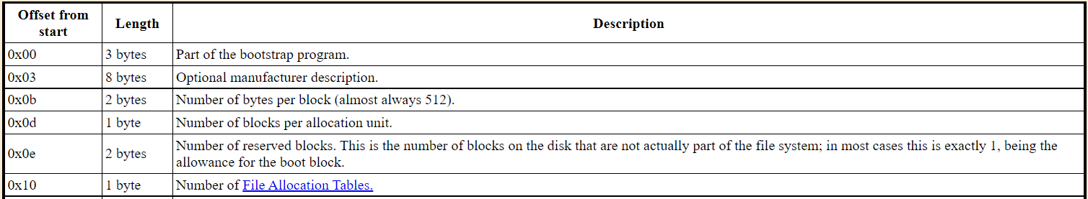
Disk Format – Boot Block
The boot block occupies just the first block of the disk. It holds a special program (the bootstrap program) which is used for loading the operating system into memory.

Slide 6
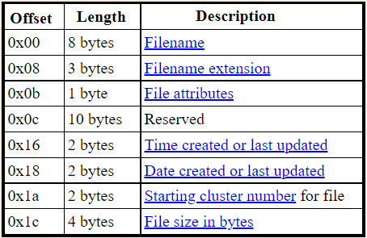
Disk Format – Root Directory

Slide 7
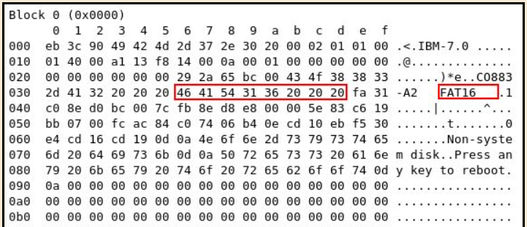
FAT Examples

Slide 8
Reference
http://www.tavi.co.uk/phobos/fat.html
https://en.wikipedia.org/wiki/Design_of_the_FAT_file_system

Slide 9
Programming Layers
Simple
Generic
main.c
main.c
Read_BootSector(), …
Hardware Abstraction Layer
Read_FAT_File()
FAT 12/16/32?
Read FAT File Layer
FAT File
Read_FAT_File()
FAT File

Slide 10
Git – Github

